Slide 1

Green Pace
Security Policy Presentation
Developer: LaTisha Burns

Slide 2

OVERVIEW: DEFENSE IN DEPTH
Green Pace’s security policy helps developers build safer software. Defense-in-depth means using more than one layer of security, such as secure coding, encryption, access control, testing, and automation. This helps protect the system even if one security layer fails.

Slide 3
THREATS MATRIX
Unlikely:
Low chance of being exploited.
Low Priority:
Lower risk or easier to fix later.
Likely:
Possible security issue that should be reviewed.
Priority:
Serious issue that should be fixed first.
Likely STD-002-CPP STD-009-CPP | Priority STD-003-CPP STD-004-CPP STD-005-CPP STD-010-CPP
Low priority STD-006-CPP STD-008-CPP | Unlikely STD-001-CPP STD-007-CPP

Slide 4
10 PRINCIPLES
Validate input data | STD-001-CPP, STD-002-CPP, STD-003-CPP, STD-004-CPP, STD-010-CPP
Heed compiler warnings | STD-009-CPP
Design for security | Secure design / access control policy
Keep it simple | STD-005-CPP, STD-006-CPP, STD-007-CPP, STD-008-CPP
Default deny | Access control policy
Use least privilege | Access control policy
Sanitize data sent to other systems | STD-003-CPP, STD-004-CPP
Practice defense-in-depth | STD-004-CPP, STD-005-CPP, STD-006-CPP, STD-007-CPP, STD-010-CPP
Use quality assurance techniques | STD-001-CPP through STD-010-CPP
Adopt a secure coding standard | STD-001-CPP through STD-010-CPP
.

Slide 5
CODING STANDARDS
Highest Priority | Supporting Standards
STD-004-CPP: Prevent SQL injection | STD-001-CPP: Check enum values
STD-005-CPP: Do not access freed memory | STD-003-CPP: Use safe string storage
STD-010-CPP: Do not read uninitialized memory | STD-006-CPP: Use assertions carefully
STD-002-CPP: Prevent integer overflow | STD-007-CPP: Avoid setjmp() and longjmp()
 | STD-008-CPP: Remove unused values STD-009-CPP: Fix compiler warnings
Ranking is based on severity, likelihood, and cost to fix.

Slide 6
ENCRYPTION POLICIES
Encryption at Rest
Protects stored data such as files, databases, and backups.
Green Pace should encrypt stored information so it cannot be easily read if accessed without permission.
Encryption in Flight
Protects data while it moves between users, systems, or networks.
Green Pace should use secure connections such as HTTPS/TLS for logins, file transfers, and API requests.
Encryption in Use
Protects data while it is being opened, changed, or processed.
Green Pace should limit access to active data and only allow approved users or systems to use it.
Encryption helps protect data during every stage of its lifecycle.

Slide 7
TRIPLE-A POLICIES
Authentication
Confirms the user is who they say they are.
Green Pace should require secure logins, strong passwords, and account verification.
Authorization
Controls what the user is allowed to access after logging in.
Green Pace should only give users access to the data and tools needed for their role.
Accounting
Tracks user and system activity.
Green Pace should log important actions such as logins, failed login attempts, database changes, and permission changes.
Triple-A supports security by controlling access and keeping a record of important activity.

Slide 8
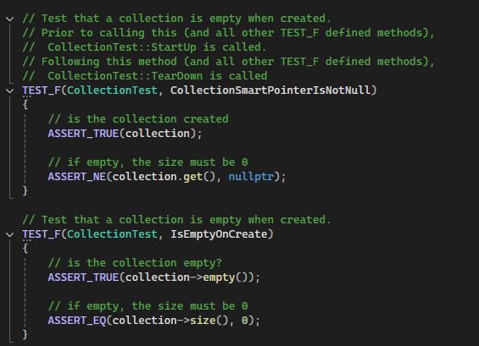
Unit Testing
Unit Test: Collection Creation
These tests confirm that the collection is created correctly, is not null, starts empty, and has a size of 0.

Slide 9
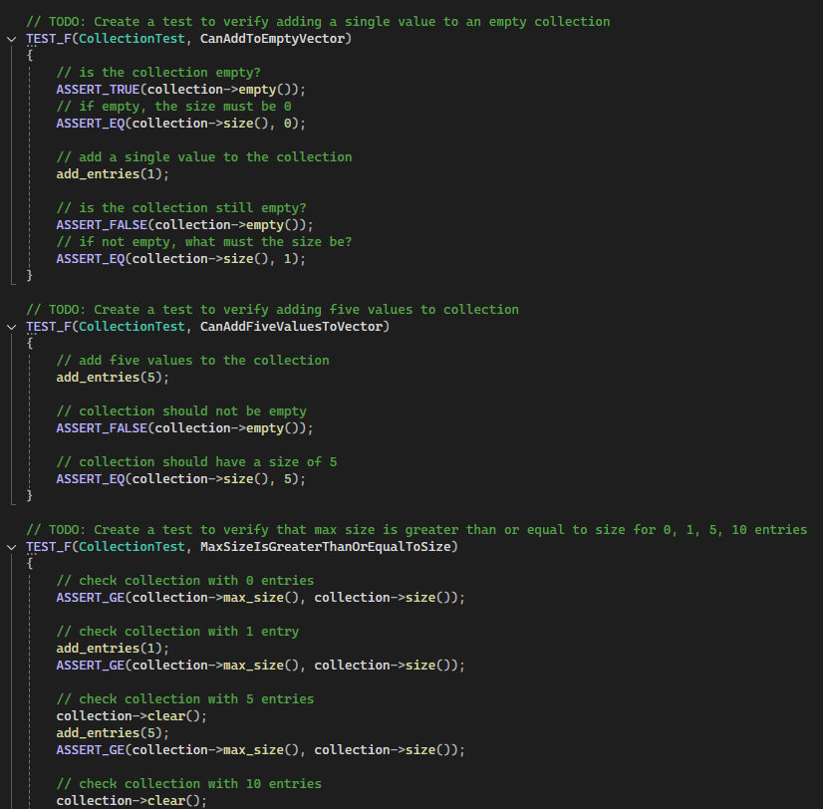
Unit Testing
Unit Test: Adding Values
These tests confirm that values can be added to the collection and that the collection size updates correctly.

Slide 10
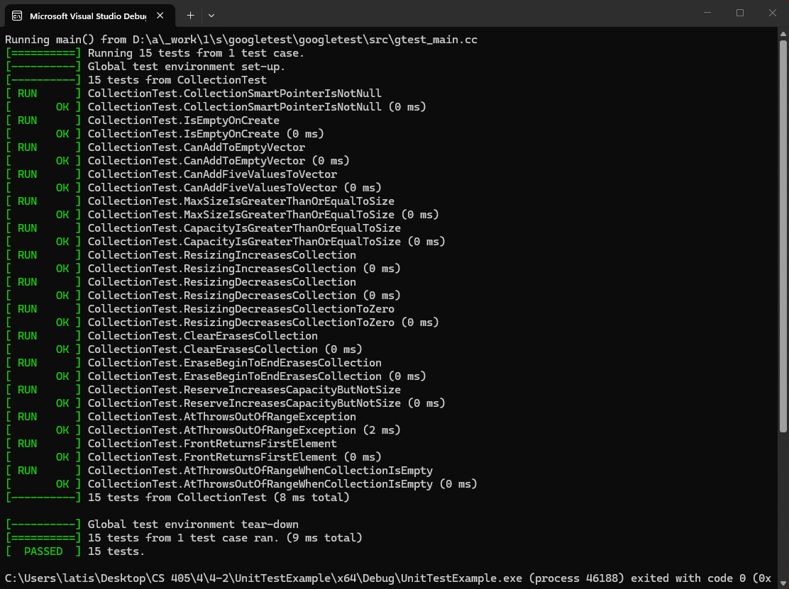
Unit Testing
Unit Test Results
All 15 unit tests passed, showing that the tested collection functions worked as expected.

Slide 11
Unit Testing
Negative Test: Out-of-Range Access
These negative tests confirm that unsafe access is handled with an exception instead of allowing the program to continue incorrectly.

Slide 12

AUTOMATION SUMMARY

Slide 13
TOOLS
Security tools should be used throughout the DevSecOps pipeline
Design: Use security policies and OWASP guidance to plan secure architecture.
Build: Use compiler warnings to catch coding mistakes early.
Test: Use unit testing and static analysis tools like Cppcheck or SonarQube.
Deploy: Use automated checks before releasing code.
Monitor: Use logging and monitoring tools to detect suspicious activity.
Automation helps Green Pace find security issues earlier and more consistently.

Slide 14
RISKS AND BENEFITS
Act Now
Finds security issues earlier.
Reduces the cost of fixing problems later.
Helps protect customer and company data.
Builds stronger security into the system from the start.
Wait
Vulnerabilities may remain in the code longer.
Fixes may take more time and cost more later.
Security issues may delay releases.
Missed problems could damage trust if a breach occurs.
The benefits of acting now is stronger protection and fewer expensive fixes later.

Slide 15
RECOMMENDATIONS
Keep the security policy updated as new threats appear.
Add more coding standards as the development team grows.
Require regular secure coding training for developers.
Use automated tools to check code during development.
Review access control policies for default deny and least privilege.
Continue using unit testing and static analysis before release.
Green Pace should treat security policy as an ongoing process, not a one-time document.

Slide 16
CONCLUSIONS
Green Pace should continue using SEI CERT C/C++ secure coding standards.
The team should adopt OWASP guidance for web application security.
Unit testing should be required before code is released.
Static analysis tools should be used during development.
Access control should follow default deny and the principle of least privilege.
Security policies should be reviewed and updated regularly.
These standards help Green Pace prevent future problems and maintain stronger security over time.

Slide 17
REFERENCES
Seacord, R. C. (2013). Secure coding in C and C++ (2nd ed.). Addison-Wesley Professional.
Mend.io. (2020, June 13). Secure coding: A practical guide. https://www.mend.io/blog/secure-coding/
Cairns, C. (2017, January 5). The basics of web application security. Martin Fowler. https://martinfowler.com/articles/web-security-basics.html
GeeksforGeeks. (2021, October 28). AAA (authentication, authorization and accounting). https://www.geeksforgeeks.org/computer-networks/computer-network-aaa-authentication-authorization-and-accounting/

